Slide 1
Lesson 1: DEBT P1: Importance of Increasing Earning Power P2: Acquiring Budgeting Skills P3: Avoiding Bad Debt: the real cost of Borrowing

Slide 2
I) Thoughts on Poverty:
For some people, “poverty is a state of mind, and having the right mind-set will let people escape poverty. ” Ben Carson{Housing&Development secretary, neurosurgeon}
In general, people fall into poverty because of poor habits
To help people escape poverty we need to educate them to develop the skills for independency
Poverty starts with a fundamental attitude, poverty is passed on, it is taught into families” R. Kiyosaki
Critique: “School system never teaches you about money, we are taught to become employees, most people lack business knowledge like accounting and taxes” that is useful for financial independence

Slide 3
II) Statistics on Canadian Debt:
Around 15% of the average Canadian income is going towards debt payment → I think it is a lot higher ~35%
Average Canadian debt rose 2.7 per cent to $72,950 (includes mortgage)
Non-mortgage debt is around $24,000, increasing around 2%/year
Divorce rate in Canada is 38%, 68% of divorces say that fighting over money is the number one reason for their divorce
Over half of Canadian families living from paycheque to paycheque and do not have any savings
57% of Canadian have credit card debt
Around 40% of Canadians don’t have any retirement savings plan
85% of Canadians believe that knowledge in financial literacy is lacking in Canada, cause for an increase in consumer debt

Slide 4
III) Thoughts on Debt:
Article: Does Mental Health cause Debt or Debt Causes Mental Illness?
People with high incomes can also be in debt if your expenses exceed your income
Overestimate our Income & Underestimate our Expenses
Common Fixed Costs: Mortgage & Debt (40% of income)
Despite a high income, you can fall in debt if you are poor at managing your finances
Not saving, racking up credit card debts, buying your toys, not knowing where your expenses are
By budgeting you can manage debt in spite of low earning power
Invest in yourself, get a good education that leads to a desirable career with high income
3 requirements for career → You like it, You are good at it, Pays well
Living in BC is expensive, raising a family is not cheap, get yourself a good education and start budgeting

Slide 5
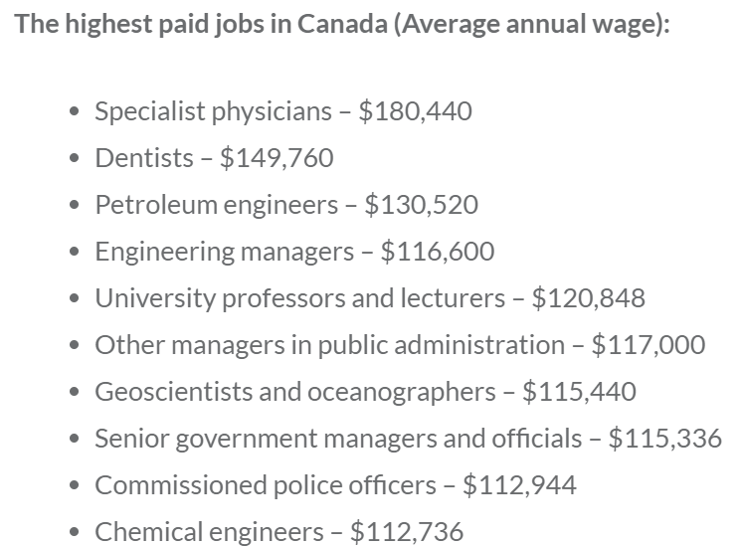
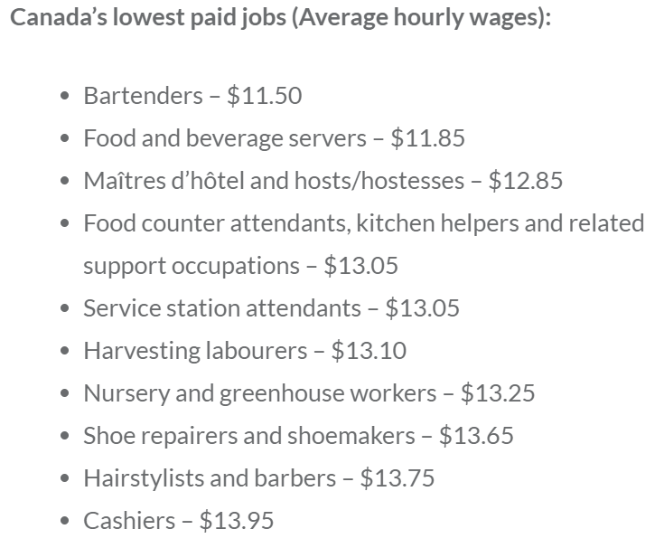
IV) Average Salaries in Canada
Many high paying careers require higher education
1.3 million STEM related jobs in Canada, average salary is $85,000/year
5.1 million BHASE related jobs in Canada, average salary is $69,000/year
670,000 HealthCare related jobs in Canada, average salary is $64,000/year
3 million Non Post Sec. related jobs in Canada, average salary is $50,000/year

Slide 6
v) Monthly Take Home Pay “THP”
“Take Home Pay” (aka Net Income) is how much you earn after paying income tax or union dues
Your “THP” depends on the provincial/federal tax brackets
Chart Below: Average income Profession 10+yrs experience
Profession Annual Income THP % Monthly THP
HS Teacher (BC)
$86,000
70%
$5020/month
$100,000
$5420/month
Sen. Acct. Manager
65%
$190,000
$9520/month
Family Physician (Dr)
60%
$49,000
$3270/month
Rt. Store Manager
80%
$90,000
$5250/month
Reg. Nurse
70%
$95,000
$5150/month
Realtor
65%
$42,000 ($20/hr)
$2800/month
Receptionist
80%
$4730/month
Programmer
$81,000
70%
$2370/month
Min. Wage (15.21/hr)
$31,636
90%
A large part of our income is for paying taxes, pension plans, employ. Insurance
Canadian Tax system → The more you make, the more tax you pay
For most professions, we only keep 60-70% of our income → overestimate how much money we make

Slide 7
vI) Budget
Gain control of your finances and create a budget
For an average take home salary of around $3200/month, this is what a budget would look like:
Expenses
Monthly Spending
Percentage
Online Budgeting template:
Housing
Template #1: MS Excel
$1,100
$35%
Food
$470
15%
Transportation
Start small and write down a few categories on where you spend money
$470
15%
Utilities
$320
10%
Debt Payments
$320
10%
Miscellaneous
Take time to track your expenses
$160
5%
Savings
$160
5%
Budgeting allows you to make the most of your money
Clothing
$80
2.5%
Medical
$80
2.5%
Total
Train yourself, gain discipline to stick to your budget
$3160
100%
Learn to save! In the next lesson you find realize the advantages of saving at an early age!

Slide 8
Expenses from an Average household income 100K (4ppl)
The following is a list of common fixed expenses for an average family of 4
Expenses
Monthly Spending
Percentage
Mortgage
70%
House (1.2mil)
$5800/month
Condo (800k)
$3900/month
47%
House In. & Prop. Tax
$700/month
8%
Day Care (2 kids)
$1200 x 2 = $2400
29%
Food & Groceries
$900/month
11%
Transportation:
Insurance
$150/month
2%
Gas
$250/month
3%
Car Payments
$250/month
3%
Phone/Internet/Util
$200/month
2.5%
Total Fixed Expense
$8750 ~ $10,650
Monthly Income
$8333.33
What common expenses are not included?

Slide 9
Good Debt vs Bad Debt
What typically separates good debt from bad debt is that good debt usually refers to debt you've taken on that will ultimately increase the value of an asset
Secured Debt: Mortgages, buying a house or valuable asset
Student loan for education to increase earning power
Investment debt: Borrowing money to invest in stocks
Bad debt is debt you've incurred to purchase items that don't generally increase in value over time; in fact, they often depreciate in value
Consumer Debt: Credit card loans
Auto Car Loans
Pay Day Loans (Worst): (SC_M Bags) Super High interest rates

Slide 10
How Loans Work: (Compound Interest)
When you borrow money from a FI (Financial Institution), the amount borrowed is called the Principal
When borrowing money, you are charged an interest rate based on the amount of the principal
The cost of borrowing money is called “Interest”
When you are making your monthly payments, it has to be greater than your monthly interest cost, in order to reduce your principal
In general → Interest is paid off first before you pay off your principal
Interest that is not paid off will be added to your principal in the next term of payment

Slide 11
Ex: A credit cash advance is where you take money out through your credit card (loan). This is different from taking money out with your debit card. The monthly interest rate is 20% starting on the date of transaction. The cash advance fee is $5 or 5%, whichever is greater. Sally borrows $500 cash. She makes a monthly payment of $150 each month. How much does she owe each month after 4 months?
Total principal and fees: $525
Interest Rate: 20% each month
Payment is $150/month
Principal
Monthly Interest
Monthly Payment
Balance Owing
$525
$105
$150
$480
$480
$96
$150
$426
$426
$85.2
$150
$361.2
$361.20
$72.24
$150
$283.44
Total
$358.44
$600

Slide 12
Suppose Sally’s monthly payment was only $100. How much would he owe at the end of each month for 12 months?
Total principal and fees: $525
Interest Rate: 20% each month
Payment is $100/month
Principal
Monthly Interest
Monthly Payment
Balance Owing
$525
$105
$100
$530
$530
$106
$100
$536
$536
$107.2
$100
$543.2
$543.2
$108.64
$100
$551.84
$551.84
$110.37
$100
$562.21
$562.21
$112.44
$100
$574.65
$574.65
$115
$100
$589.58
$589.58
$118
$100
$607.50
$607.50
$121.5
$100
$629
$629
$125.8
$100
$654.8
$654.8
$130.96
$100
685.75
$685.75
$137.15
$100
$722.90

Slide 13
Credit Card Interest Rates (Compound Interest)
Compound interest is the addition of interest to the principal sum of a loan/deposit
“Interest on Interest”
A: Accumulated amount
P: Principal
“r”: Your annual interest rate (Not monthly)
“n”: Number of compounds in a year
Ie: Monthly – n = 12, Daily: n = 365, “Payday”: n=26
“t”: Number of years
3 years: t = 3, 3 months: n = ¼ 26 weeks: n = 0.5

Slide 14
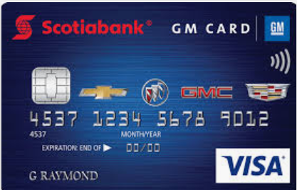
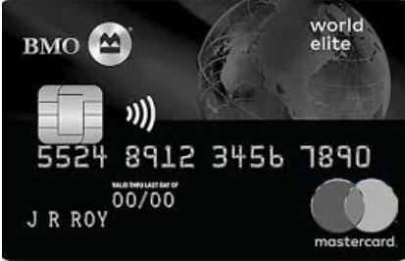
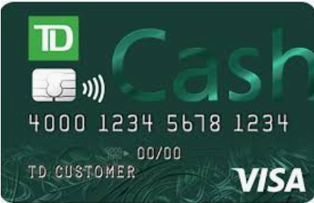
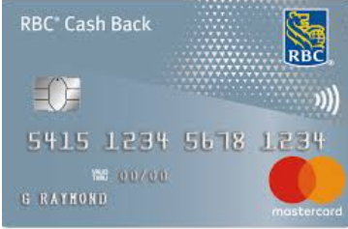
Annual Interest Rate from Different Credit Cards
Costco
Annual I.R = 25%
3% & 2% Cash back
Annual I.R = 25%
No Limit
Annual I.R = 25%
Points
Miles Reward
Annual I.R = 19%
Annual Fee: $20/yr Good for travelling
Annual I.R = 13%
TD
Annual I.R = 16%

Slide 15
Ex: Credit card interest rates are calculated based on the unpaid balance owing. If Johnny’s balance is $1000 this month and he forgot to pay after six monthly terms, how much would he owe? Note: Annual Interest rate on his credit card is 20%.

Slide 16
Strategies for Avoiding DEBT:
1. Don’t spend/waist money on things that you don’t need
Do you need a new phone every year? 2 years?
Have a clear perspective of all your expenses
Minimize Subscriptions, membership fees, service charge, cable,
2. Live within your means – clothing, car,
Don’t be enslaved to materialism
Buy things on sale (wait for it)
3. Save – create a savings account, goal: 10% of your income
Pay yourself first
4. Invest Early - invest into your Tax Free Savings Account, Registered Retirement Savings Plan
Your biggest asset when as a young adult is your time
5. Pay Cash, if you use credit, pay it off every month

Slide 17
More Strategies to Save up
Always pay off your highest interest rate debt first
Ie: If your bank is giving you 5% interest and your credit card charges 20% interest, pay off your credit card first!
Create an Emergency fund Goal: Save up for 6 months to 12 months of your living expense
Avoid having to borrow money with high interest
Cut down your Variable expenses – eating out, drinking, groceries, subscriptions, shopping, buy in bulk
Learn to invest and create passive income (next lesson)
Invest in yourself through education, increase earning power
Knowledge is power!
Understand how the tax system works, find out how to reduce your tax (Lesson 3)

Slide 18
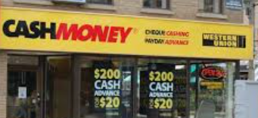
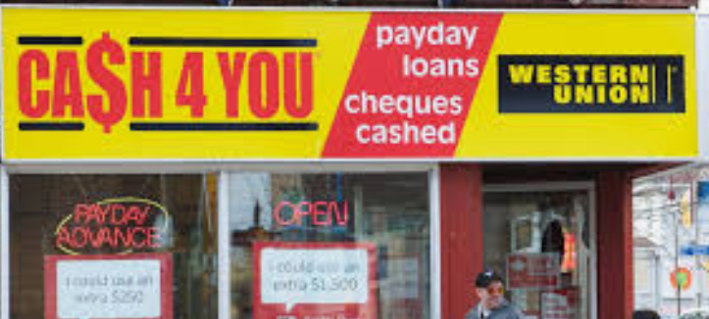
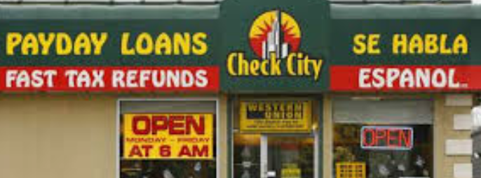
Very Bad Debt (Pay Day Loans)
People with bad credit that can not borrow money from most financial institutions with a lower interest rate would borrow a “Pay Day Loan”
Need quick cash? Payday loan are like traps.
Astronomical Interest rates. IN BC, you pay $15 interest for every $100 you borrow for two weeks.
EX: If I borrowed $1000 to buy an iphone, how much would I need to pay back in 8weeks? (4 terms)
If I borrowed $100, how much would I owe after 1 year (26 terms)
What is the annual interest rate for this pay day loan?

Slide 20
Youtube Videos on Debt
Disclaimer, some of these videos may show graphic images or depressing stories that may create negative emotions. Watch at your own risk:
When watching these videos, avoid scam/ads that talk about making money quick
Growing debt in Korean Youths: https://youtu.be/E8cbwbTqmCw
Elderly couple drowning in credit card debts: https://youtu.be/hu9zH9CRQHo
Young couple saving 20k in a year: https://youtu.be/d-QcsO4JAns
Extreme Couponing, shopping with coupons https://youtu.be/NkOxfoVOl2g
Basics on Budgeting https://youtu.be/sVKQn2I4HDM

Slide 21
HW: Create a budget with your family. Track your family expenses for the next three months. Use the template provided or create your own.
Template #1: MS Excel

